Slide 1
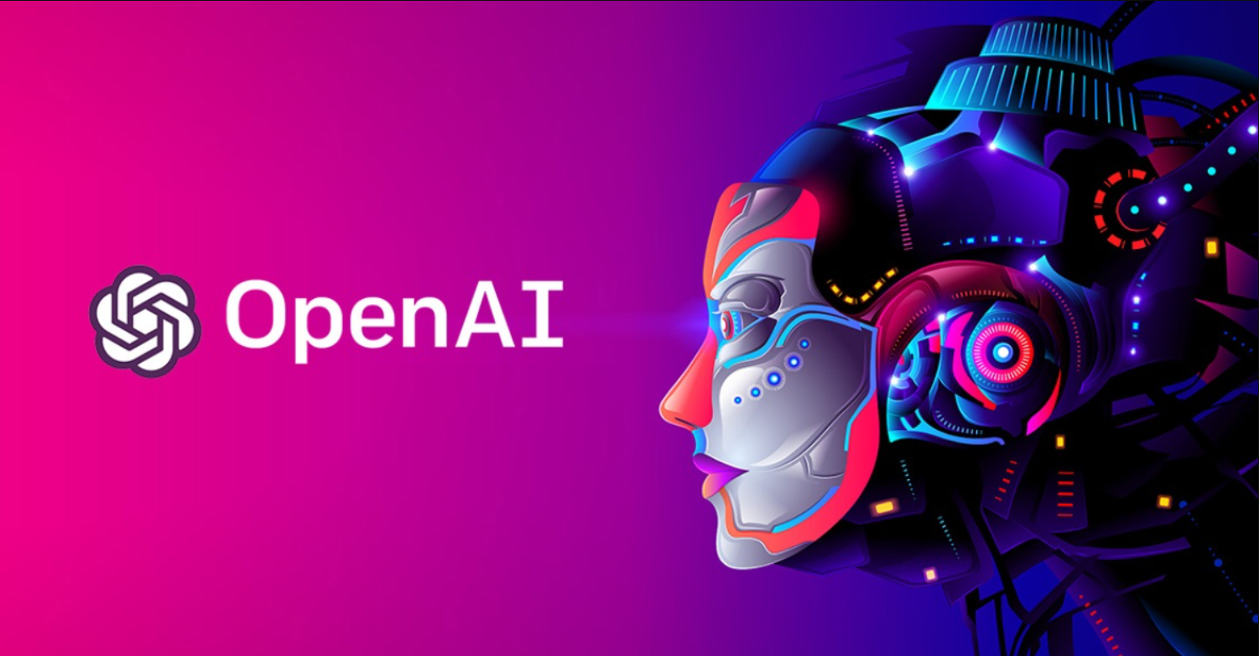
Introduction to GPT-2
Students: Đỗ Phạm Quang Hưng – 520K0127
Lê Phước Thịnh – 520K0343
Lecturer: Prof. Lê Anh Cường

Slide 2

What to expect from this presentation? :O
What is GPT-2?
2. Evolution from GPT-1 to GPT-2
3. What are some special features of GPT-2?
4. Architecture of GPT-2
5. Fine-tuning
6. Achievements
7. Limitations

Slide 3

What is model GPT-2?
GPT-2 stands for (Generative Pre-trained Transformer 2).
OpenAI GPT-2 model was proposed in Language Models are Unsupervised Multitask Learners by Alec Radford, Jeffrey Wu, Rewon Child, David Luan, Dario Amodei and Ilya Sutskever in Feb 2019.
When GPT-2 was released in 2019, the natural language processing (NLP) industry was rapidly growing and expanding. The use of machine learning and deep learning techniques for NLP tasks, such as text classification, sentiment analysis, and language translation, had become increasingly popular.
The release of GPT-2 also highlighted the potential ethical concerns associated with advanced NLP models. Its creators initially chose not to release the full version of the model due to concerns about the potential misuse of the technology, such as the generation of fake news or malicious text. However, the model was eventually released in full, with some precautions put in place to mitigate these risks.

Slide 4
What is model GPT-2?
The model is a causal (unidirectional) transformer pretrained using language modeling on a very large corpus of ~40 GB of text data, from over 8 million documents.
GPT-2 has 1.5 billion parameters, making it one of the largest language models in existence. It has been trained on a diverse range of internet text, which allows it to generate coherent and fluent text across a wide range of topics and writing styles.
The model has been used for a variety of natural language processing tasks, including language translation, question answering, and text completion.
GPT-2 has been widely used in research and industry, and it remains a significant milestone in the development of advanced natural language processing technology.

Slide 5
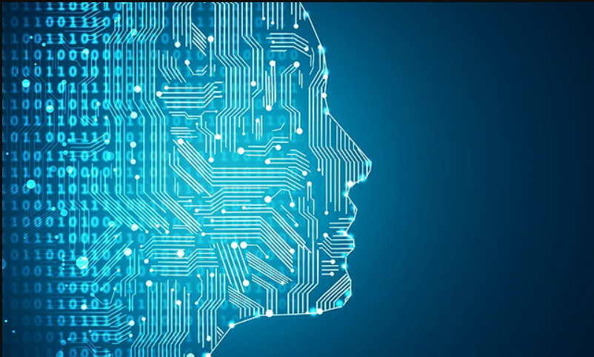
Evolution from GPT to GPT-2
1. Size: GPT-2 is a much larger model than GPT-1. GPT-1 had 117 million parameters, while GPT-2 has 1.5 billion parameters.
2. Performance: GPT-2 has been shown to perform significantly better than GPT-1 on a range of natural language processing tasks, including text completion, question answering, and language translation.
3. Control: GPT-2 includes a control mechanism that allows users to specify the content and style of the text generated by the model. This gives users more control over the output of the model and allows them to generate more diverse and tailored text.
4. Controversy: GPT-2 generated controversy upon its release due to concerns about the potential for it to be used to generate large amounts of convincing fake news or propaganda. As a result, OpenAI initially limited access to the model, though they have since released it to the public.
The GPT-2 inherited many traits from its predecessor GPT-1, but there are many keys differences that make GPT-2 more efficient.

Slide 6
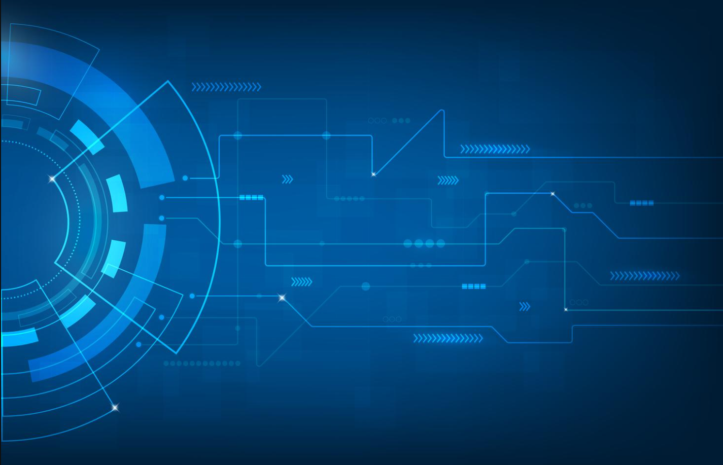
Special features of GPT-2
Zero shot learning
Zero-shot learning is a capability of GPT-2 that allows it to perform a natural language processing task without any specific training or fine-tuning for that task. This means that GPT-2 can generate coherent and relevant text for a task it has not been explicitly trained on.
The zero-shot capability of GPT-2 is achieved by leveraging its ability to understand the semantic relationships between words and phrases in natural language. By conditioning the model on a prompt or set of prompts that contain information about the desired output, GPT-2 can generate text that is relevant to the task at hand, even if it has not been fine-tuned on that task.
Zero-shot learning is particularly useful in situations where there is not enough training data available to fine-tune a model for a specific task. It allows GPT-2 to perform tasks that it has never seen before, making it a versatile tool for natural language processing tasks. Some examples of tasks that can be performed using zero-shot learning in GPT-2 include sentiment analysis, text classification, and question answering.

Slide 7
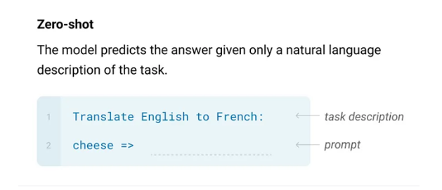
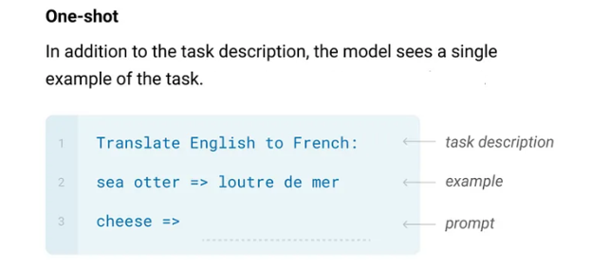
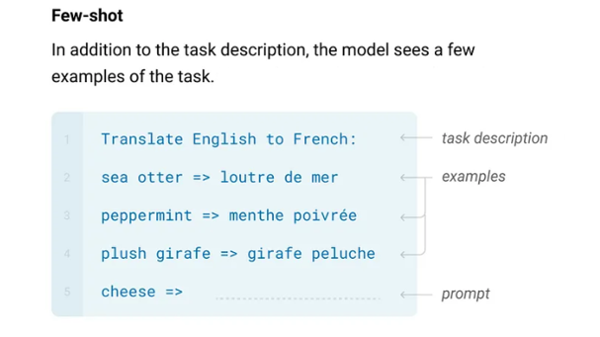
Special features of GPT-2

Slide 8
Special features of GPT-2
BPE Tokenization
GPT-2 (Generative Pre-trained Transformer 2) uses byte pair encoding (BPE) for tokenization. BPE is a data compression technique that breaks down words into subword units or tokens based on their frequency of occurrence in the training data. The most frequent pairs of adjacent bytes are iteratively merged to form new tokens until a maximum vocabulary size is reached.
BPE is particularly effective for handling rare or unknown words and can help improve the performance of language models on a wide range of natural language processing tasks. By breaking down words into sub-word units, the model can better capture the underlying structure and meaning of the text, even when faced with new or previously unseen words.

Slide 9
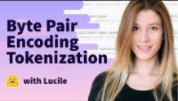
Special features of GPT-2
BPE Tokenization

Slide 10

Architects of GPT-2
GPT-2 has a total of 48 layers, which are organized into two components: the transformer encoder and the transformer decoder.
The transformer Encoder consists of 12 identical layers, each of which has the following components:
Multi-head self-attention mechanism: This component allows the model to attend to different parts of the input sequence simultaneously, enabling it to learn complex relationships between the input tokens.
Layer normalization: This component normalizes the output of the self-attention mechanism to ensure that the model is able to learn stable and consistent representations.
Feedforward neural network: This component applies a non-linear transformation to the output of the self-attention mechanism, allowing the model to capture more complex interactions between the input tokens.
4. Additional layer normalization: This component further normalizes the output of the feedforward neural network.

Slide 11
Architects of GPT-2
The transformer Decoder also consists of 12 identical layers, each of which has the following components:
Masked multi-head self-attention mechanism: This component is similar to the self-attention mechanism in the encoder, but is modified to allow the model to attend only to previous tokens in the output sequence, preventing it from "cheating" by looking ahead in the sequence.
Layer normalization: This component performs the same function as in the encoder.
Multi-head attention mechanism: This component allows the model to attend to different parts of the input sequence, based on the current state of the decoder and the output sequence generated so far.
Layer normalization: This component performs the same function as in the encoder.
5. Feedforward neural network: This component performs the same function as in the encoder.
6. Additional layer normalization: This component performs the same function as in the encoder

Slide 12
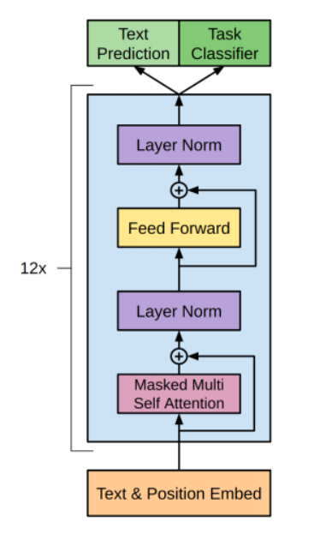
Architects of GPT-2
An example of the decoder layer of GPT-2

Slide 13
Architects of GPT-2
At a high level, the GPT-2 model takes in a sequence of tokens as input and generates a sequence of tokens as output. The input sequence is processed by the transformer layers, which use attention mechanisms to focus on the most relevant parts of the input for each output token.
The model is trained in an unsupervised manner on a large corpus of text data, using a technique called masked language modeling. During training, some of the input tokens are randomly masked and the model is tasked with predicting the masked tokens based on the context of the surrounding tokens.
Once trained, the GPT-2 model can be fine-tuned on specific natural language processing tasks, such as language translation, text completion, or question answering. The model has been shown to be highly effective at a wide range of natural language processing tasks, due in part to its large size and sophisticated architecture.

Slide 14
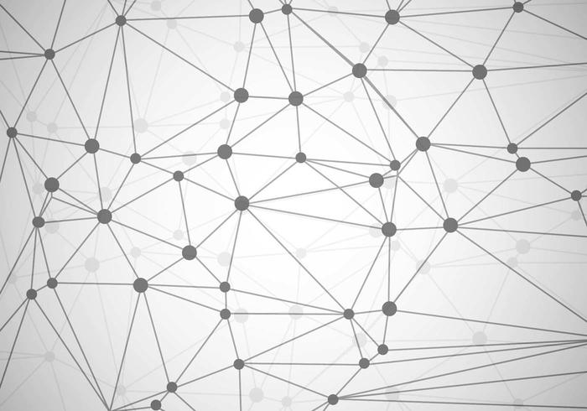
Fine-tune GPT-2 to fit your needs?
The fine-tuning process involves adjusting the weights of the model's parameters to better fit the specific task at hand. This is done by feeding the task-specific examples into the model and using backpropagation to update the weights based on the difference between the model's output and the desired output for each example.
For example, if the task is text classification, the fine-tuning dataset would consist of examples of text with their corresponding labels (e.g., positive or negative sentiment). The model would then be trained on this dataset by minimizing a loss function that measures the difference between the predicted labels and the true labels.

Slide 15

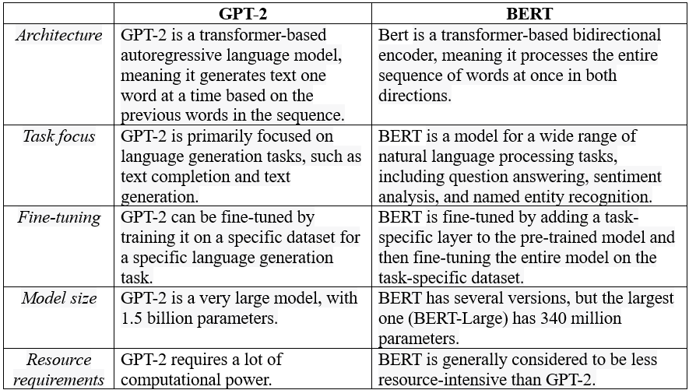
GPT-2 vs BERT

Slide 16
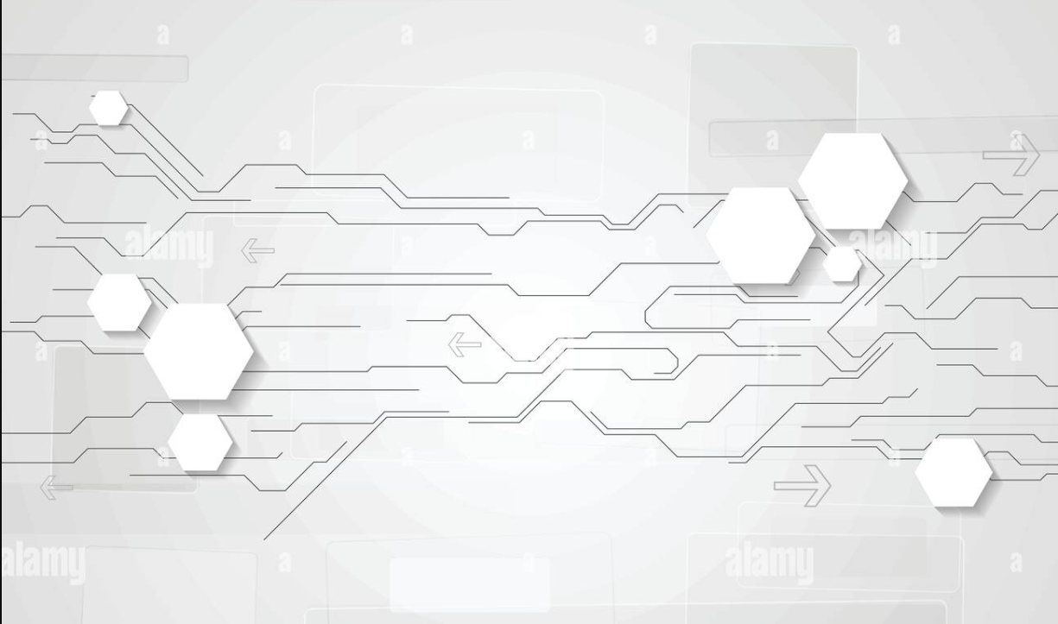
Achievements of GPT-2
Language modeling: GPT-2 has set new records for language modeling, which is the task of predicting the probability distribution of the next word in a sequence given the previous words. For example, the model achieved a perplexity score of 20.5 on the One Billion Word benchmark, which is the lowest ever reported on this dataset.
Text generation: GPT-2 is known for its ability to generate high-quality, coherent text in a variety of styles and genres, including news articles, fiction, and poetry. In some cases, its output is difficult to distinguish from text written by humans.
Translation: GPT-2 has achieved impressive results on machine translation tasks, outperforming other state-of-the-art models on several benchmark datasets.
4. Question-answering: GPT-2 has also demonstrated strong performance on question-answering tasks, such as the Stanford Question Answering Dataset (SQuAD), where it achieved a score of 76.1, which was the highest at the time of its release.
GPT-2 has achieved state-of-the-art results on a wide range of natural language processing (NLP) tasks, which has contributed to its reputation as a highly effective language model.

Slide 17

Limitations of GPT-2
Biases: GPT-2, like all language models, can reflect biases in the data it was trained on. This can lead to biased language output and perpetuate harmful stereotypes and prejudices. There have been concerns raised about GPT-2's potential to spread misinformation and generate biased content.
Limited understanding of context: GPT-2 may struggle with understanding the full context of a given text, which can lead to incorrect or irrelevant responses. This is particularly true in cases where there is a lot of ambiguity or multiple possible interpretations.
Resource-intensive: GPT-2 requires a significant amount of computing power and storage space, making it difficult for individuals or organizations without access to large-scale computing resources to use it effectively.
4. Ethical concerns: Due to its potential to generate high-quality, human-like text, there are ethical concerns about the misuse of GPT-2, such as the creation of fake news, propaganda, or malicious content.

Slide 18

GPT-2 is considered to be one of the most powerful and versatile language models currently available. It has achieved state-of-the-art results on a wide range of natural language processing (NLP) tasks.
GPT-2 is widely regarded as a highly impressive and powerful language model, with a range of practical applications in NLP tasks such as content generation, chatbots, and language translation.
Its success has inspired further research into even more advanced language models, such as GPT-3, which has even larger parameters and greater capabilities.

Slide 19

End of GPT-2 presentation
Thanks for listening!
Hope you’ve learnt something new
Đỗ Phạm Quang Hưng
Lê Phước Thịnh

